Slide 1


CompSci club
Practice with Conditionals
Conditionals are incredible, so it’s important that we understand how to use them!

Slide 2

Our person of the day!
Robert Tappan Morris
On November 2nd, 1988, Robert Tappan Morris, then a graduate student at Cornell University, made a bit of a mistake
In an effort to see if a computer worm could be made, Morris deployed a computer worm that would exploit weak passwords
He deployed the worm at MIT, hoping that the creator would be thought to study there
His worm targeted Unix systems, an operating system his father help make
Morris’s goal wasn’t to create something destructive, he simply wanted to show the weaknesses of networks at the time
It turned costly thought when Morris included a feature that would duplicate the worm 14% of the time regardless of previous infection status
The worm caused $100,000 to $10,000,000 in damage, and reportedly infected 2,000 computers in 15 hours
Morris was put 3 years on probation, with 400 hours of community service and a $13,000 fine
Creator of the first Computer worm

Slide 3



Roadmap for Today
Random Module
This is a commonly used library that we didn’t cover last week
A deeper look at conditionals
The logic behind conditionals is what is going to aid you in the long run!
Practice with Conditionals
Alas, practice makes perfect! (or as Mr. Setubal likes say, “Perfect Practice makes Perfect”)

Slide 4
Randomness is a surprisingly commonly used part of programming!
A look at the
Random Module

Slide 5
Random Module
import random as rand
elements = ["Water", "Fire", "Air", "Earth"]
print(rand.random()) #0.8341936011525182
print(rand.randint(1,11)) #5
print(rand.choice(elements)) #Air
The random module is one of the built-in packages into Python, and provides a lot of useful methods and functions that are centered around randomness
We will most likely use this later in the year, so here are some common methods!
rand.random() - Generates a random float between 0 and 1
rand.randint(a,b) - Generates a random integer between a and b+1
rand.choice(seq) - Picks a random element from a sequence (like a list)
rand.shuffle(seq) - Randomly shuffles up a list (modifies the list directly)
rand.sample(population, k) - Takes k amount of elements from the population without replacement
The random docs are a great place to learn more!
import random as rand
friends = ["Bob", "Elmo", "Cookie Monster", "Clifford", "Caillou"]
rand.shuffle(friends)
print(friends) #['Clifford', 'Cookie Monster', 'Caillou', 'Elmo', 'Bob']
Notes:
Want to know the difference between rand.choices and rand.sample? Check out this post! https://stackoverflow.com/a/59763969

Slide 6
Regardless of what language you decide to pursue in the future, this will be of great use!
An explanation of
Conditional Logic

Slide 7
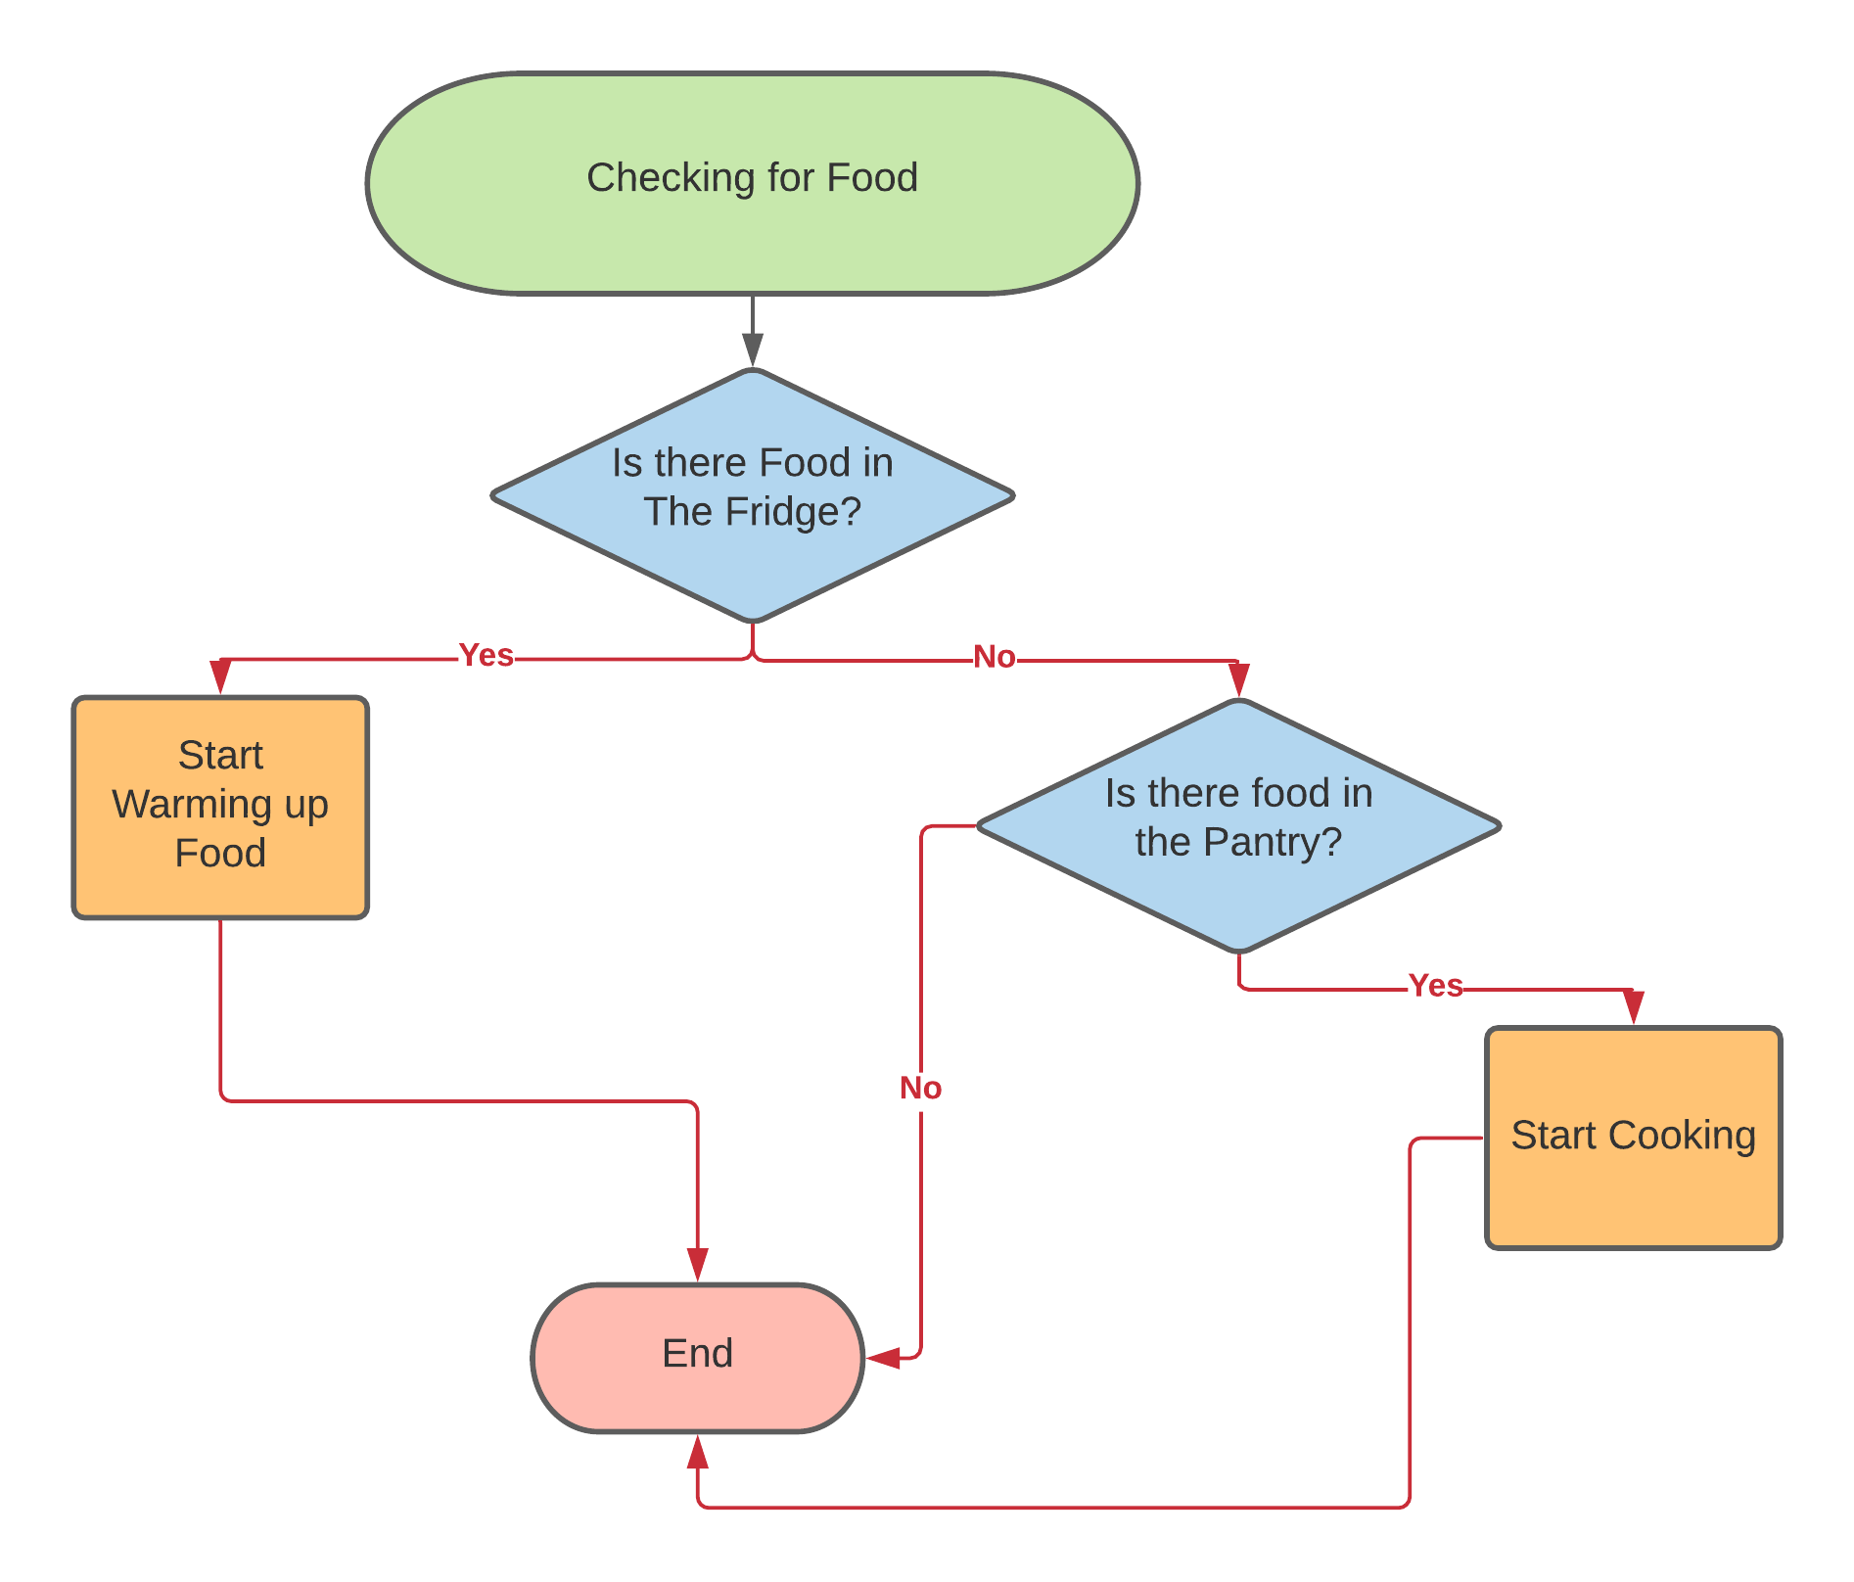
Intro of conditional logic
Let’s pretend you are hungry (maybe you are)
What are some of the decisions you are going to make?
You might go into your fridge, and then make a series of decisions based on that
If you have to nothing in your fridge, you are going to do something else
This is how conditionals work in programming!
Based on if something is True or False, we can fire a certain block of code
You can imagine that we expand this a bit more
Before we give up on having food, we can check if there is anything in the pantry

Slide 8
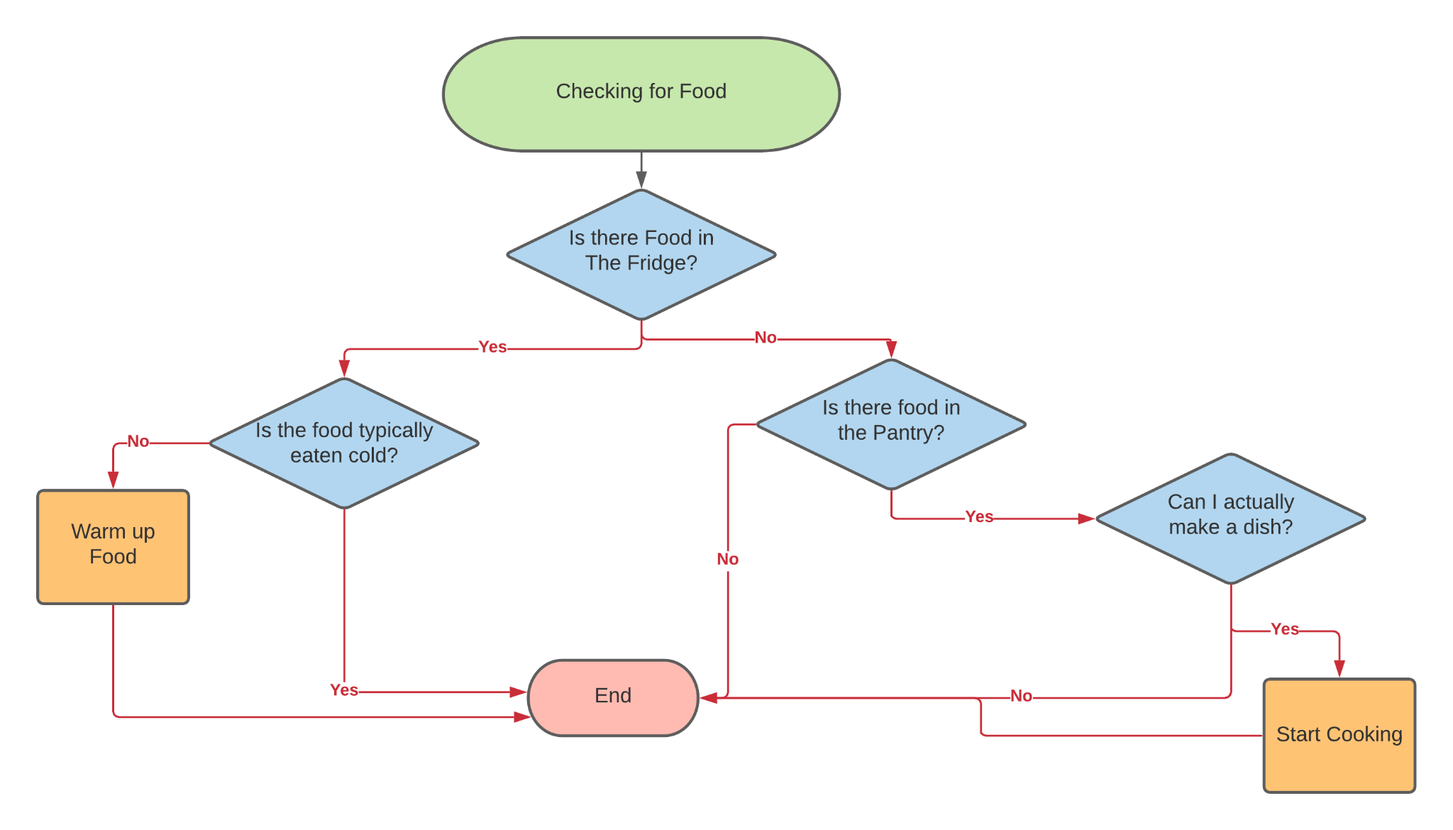
Complex conditional logic
You can probably quickly see how we can scale up this entire process to encapsulate more complex decisions
For example, we can make specific decisions based on what is in the fridge
This would be the equivalent of nesting if statements inside other if statements inside Python
This process help explains why we want to generally go from most to least specific with our if statements
Our else statement acts as a ‘catch all’ that executes only if all of our other conditions return False

Slide 9
Finally, we have some practice for you all!
Practice
With Conditionals

Slide 10
Problem Set One
Exercise One:
You are the bouncer at homecoming (which is this Friday!)
You are going to check if someone is one the ‘list’ for homecoming
Create a list of first names
Then, using conditionals, check if the name is in the list
If they are on the list, print out a message allowing them in
If they are not, deny them entry
Exercise Two:
Take the above exercise a step further by asking them for their age
If the person is between the ages of 15 and 18, ask them if they are from Raleigh Charter
If they are, let them in! (Though, they technically need to pay $10)
Throughout the entire process, ensure that you have print statements if they do not meet the conditions!

Slide 11
Problem Set One
Exercise One:
Yesterday during Halloween, you got a ton of candy!
But, you want to trade some with your friends
You ask them what candy they got
Based off what their response is, print out a statement with your opinion and your offer if you want the candy
Example: Wow! I love Hershey! I will trade you two Whoppers
Exercise Two:
Expand this a step further, asking specific questions about candies before you make a offer
For example, let’s say you really love Airheads, but only the blue ones, ask that before you make an offer!
Error Handling: If they give you a candy that you don’t specify, print out a statement that acknowledges that; something to similar to “I don’t know what candy that is!”

Slide 12
We will cover the last new topic next week before your first project!
Thank you!
That is all we have for today!

